Slide 1
Week 2
Cryptanalysis of RSA (Rivest–Shamir–Adleman)

Slide 2
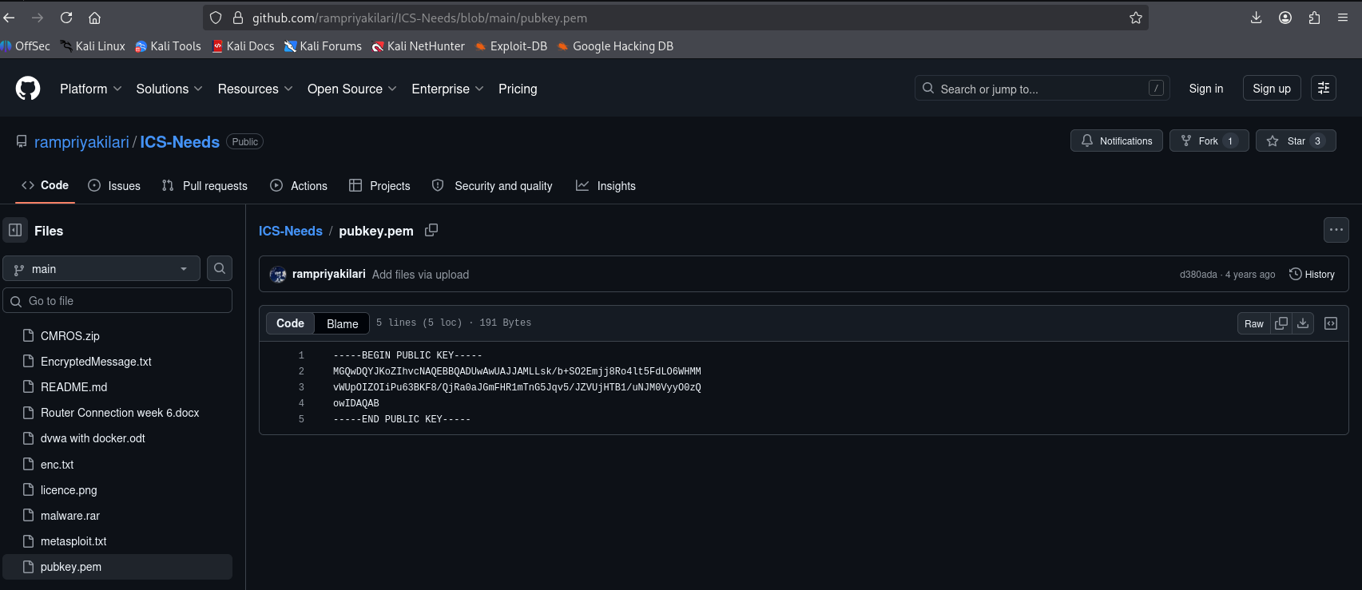
Step 1:- Download Files From github.com/rampriyakilari/ICS-Needs

Slide 3
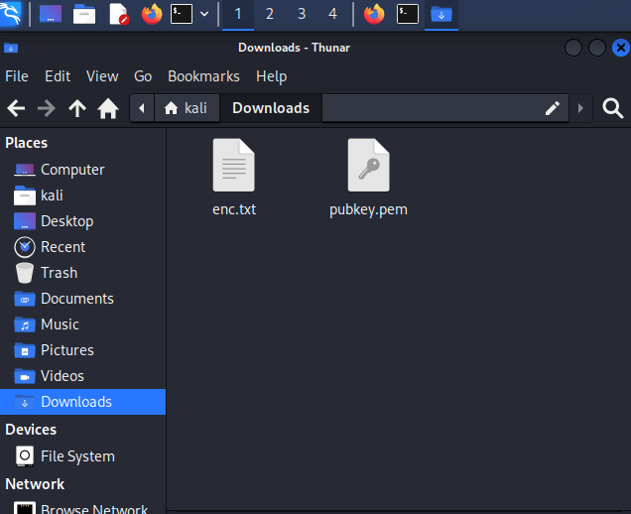
Downloaded enc.txt and pubkey.pem

Slide 4
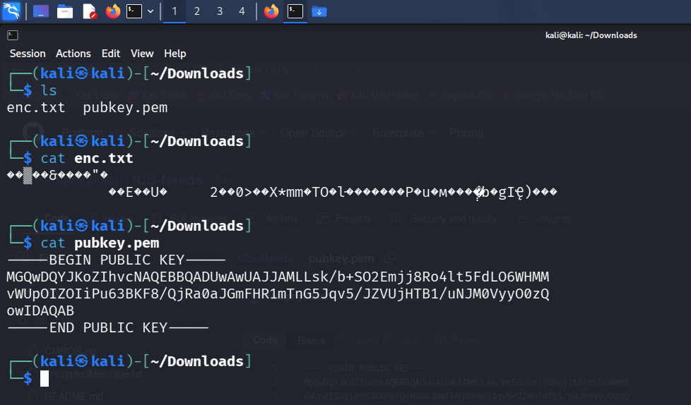
Step 2:- Check using cat command.

Slide 5
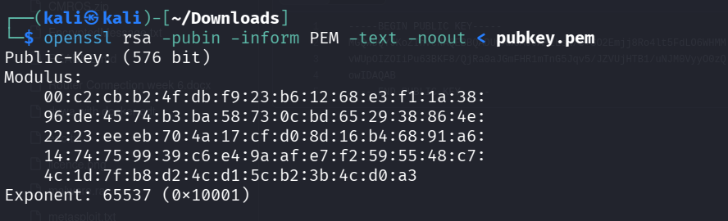
Here pubkey.pem(privacy enhanced mail) hexadecimal openssl rsa -pubin -inform PEM -text -noout < pubkey.pem

Slide 6
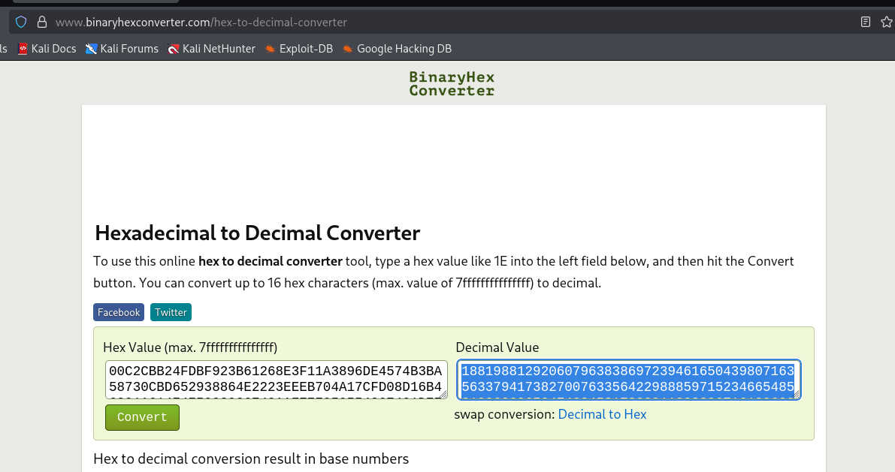
convert hexadecimal to decimal

Slide 7
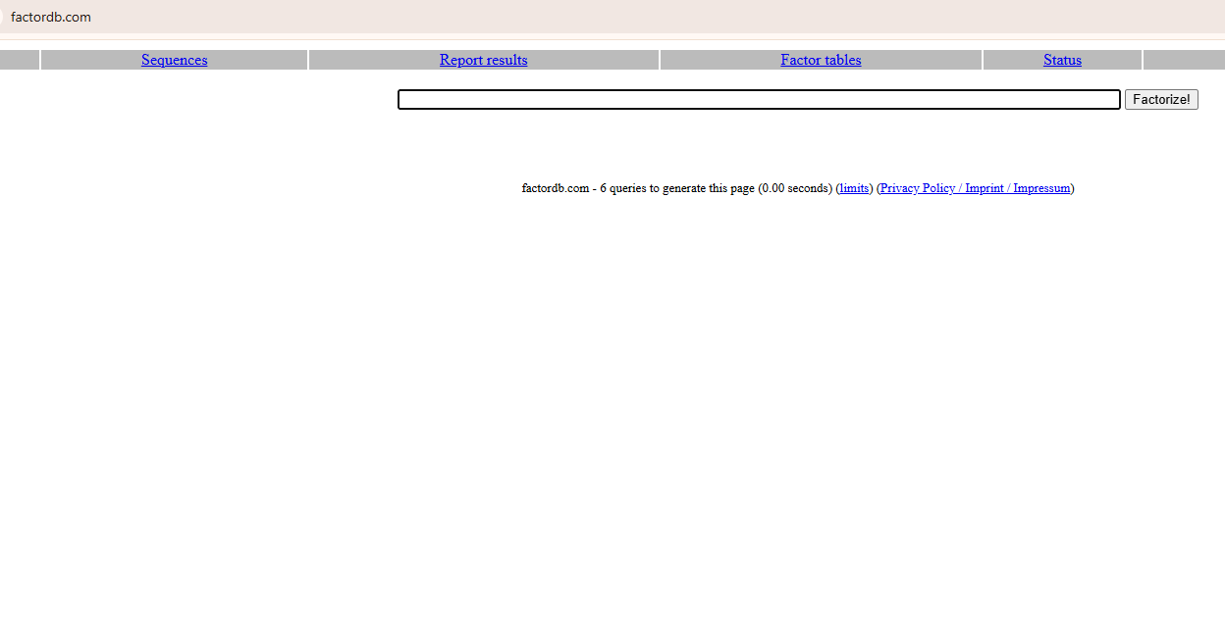
Step 3:-Use factordb.com to take p and q value

Slide 8
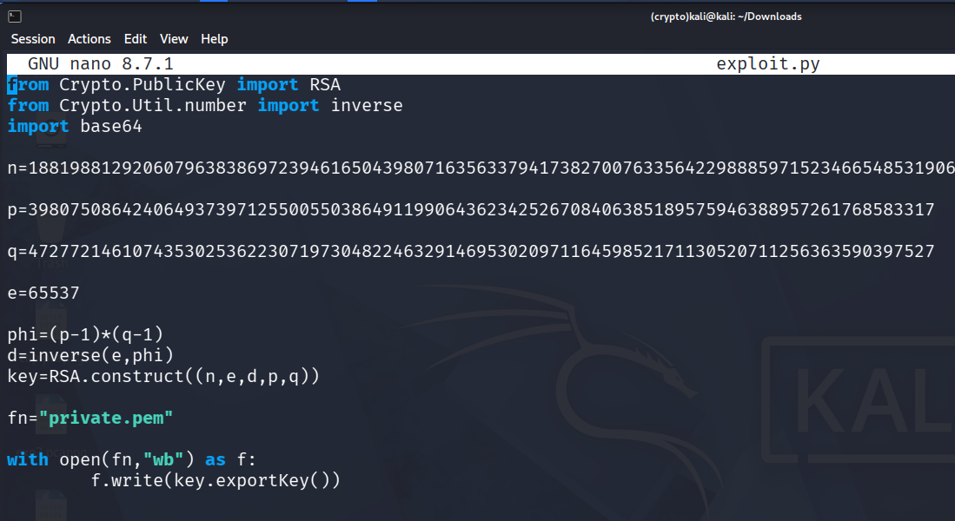
Step 4:-nano exploit.py (Ctrl+X,Y,Enter)Exit Purpose.

Slide 9
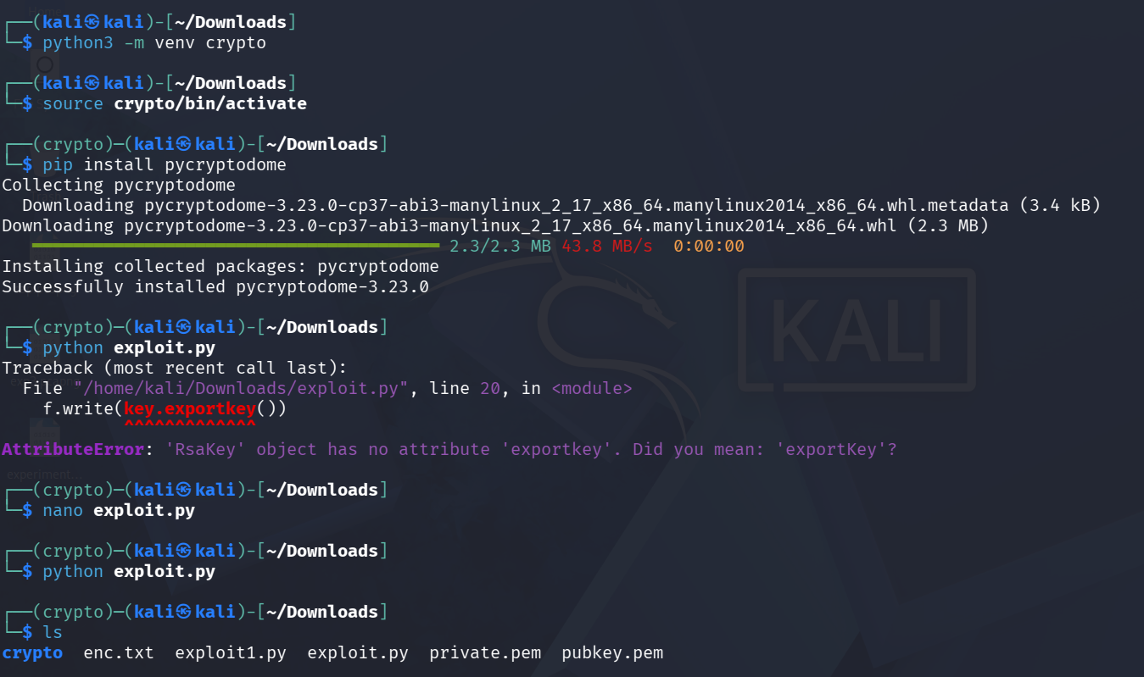
Step 5:-Exploit.py code using to Generated private.pem

Slide 10
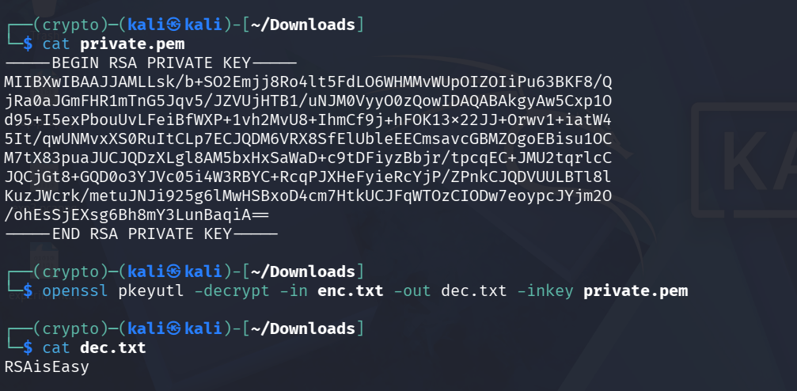
Step 6:-Use following Command to Decrypt openssl pkeyutl -decrypt -in enc.txt -out dec.txt -inkey private.pem

Slide 11
Note:- python code and commands must and should write in records based on steps.
Result:- Successfully generated the RSA private keys using public key and encrypted message, and decrypted the ciphertext using the private key. The original message was recovered successfully, verifying the correctness of the RSA algorithm.

